Slide 1
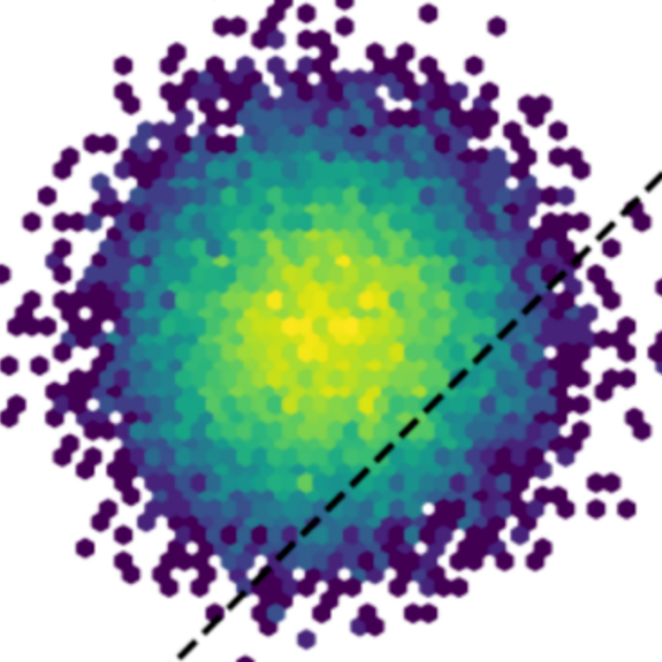
Scientific data analysis workshop
With Python
https://www.facebook.com/Datanoxfour

Slide 2
Introduction

Slide 3
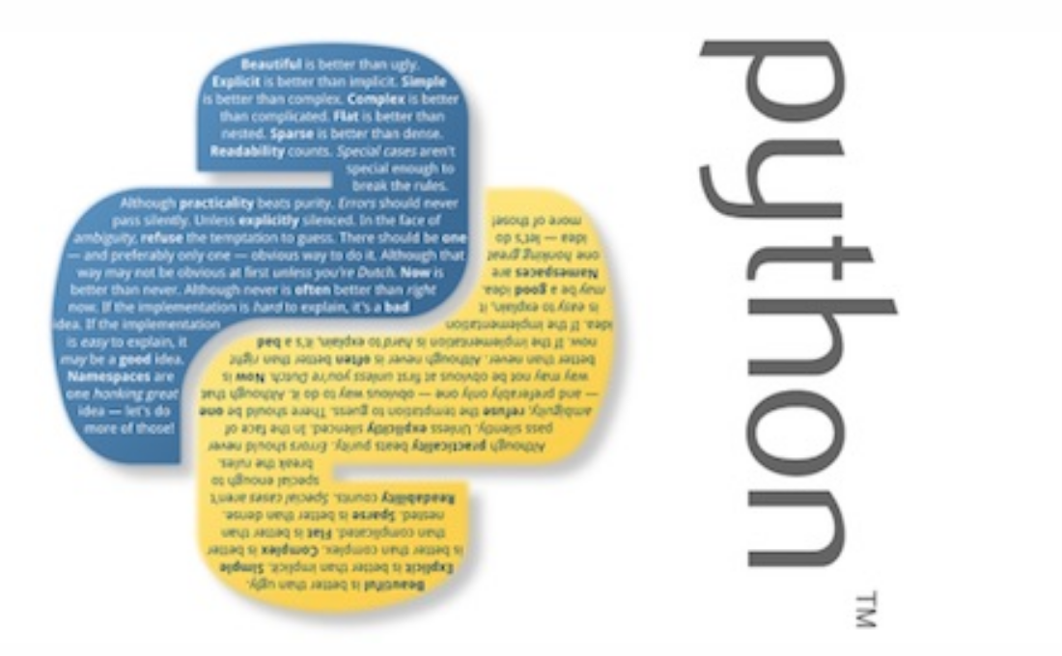
Introduction
Arguably, the most popular programming language in Research sector
High level language (https://docs.anaconda.com/anaconda/install/)
Dynamically type
Rich community support
Legacy codes

Slide 4
Workshop Scope
Introduce Python and its scientific modules/ecosystem
Hands-on coding experience
Numerical and statistical analysis
Data preprocessing
Data visualisation
Project of your choice

Slide 5
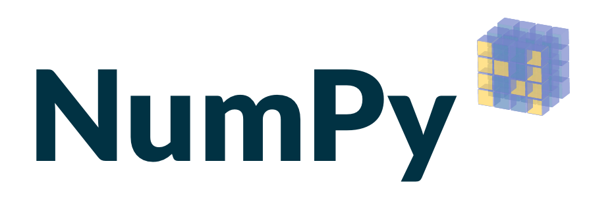


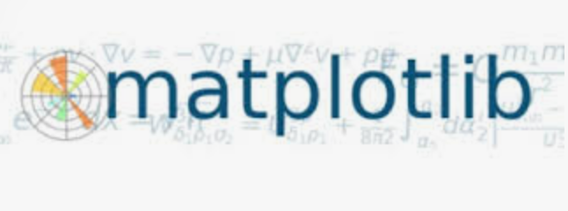


Modules in Python
Numpy: numerical computing
Scipy: mathematical, statistical, engineering
Matplotlib: visualisation
Pandas: data manipulation
Scikit-learn: Machine Learning
Jupyter: web based application for coding
Sympy: symbolic calculation

Slide 6
Reference material
Pine David: Introduction to Python for Science and Engineering
Wes McKinney: Python for Data Analysis

